Slide 1
Advanced Convolutional Neural Networks
Instructor: Revendranath T

Slide 2
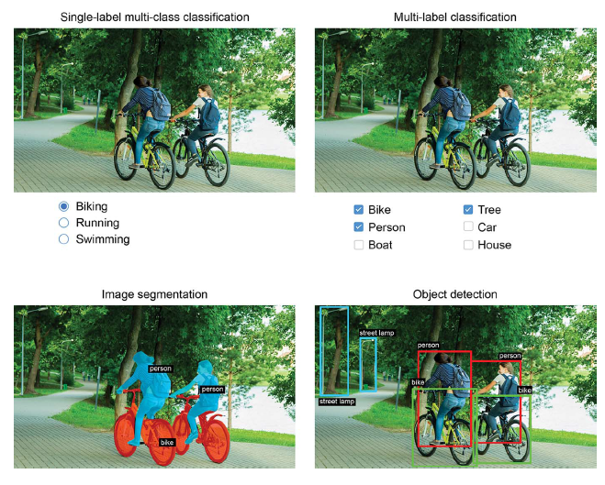
Three essential computer vision tasks
Image classification
Image segmentation
Object detection

Slide 3
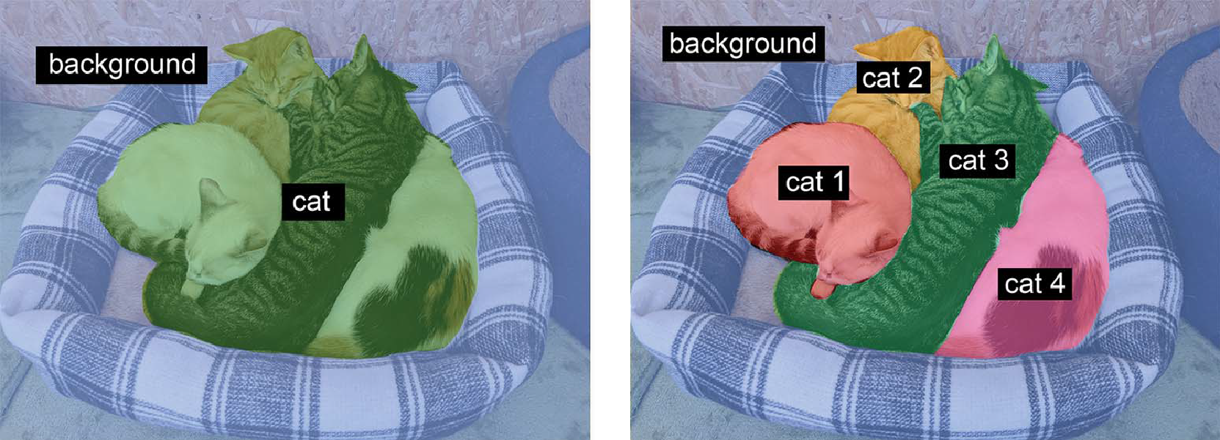
Image Segmentation
Semantic segmentation Instance segmentation

Slide 4
Image Segmentation
Semantic segmentation
Each pixel is independently classified into a semantic category, like “cat.”
If there are two cats in the image, the corresponding pixels are all mapped to the same generic “cat” category.
Instance segmentation
seeks not only to classify image pixels by category, but also to parse out individual object instances.
In an image with two cats in it, instance segmentation would treat “cat 1” and “cat 2” as two separate classes of pixels

Slide 5
Image Segmentation
Every training image has a corresponding segmentation mask
Segmentation mask:
The image-segmentation equivalent of a label
is an image the same size as the input image, with a single color channel where each integer value corresponds to the class of the corresponding pixel in the input image.
The pixels of our segmentation masks can take one of three integer values:
1 (foreground)
2 (background)
3 (contour)

Slide 6
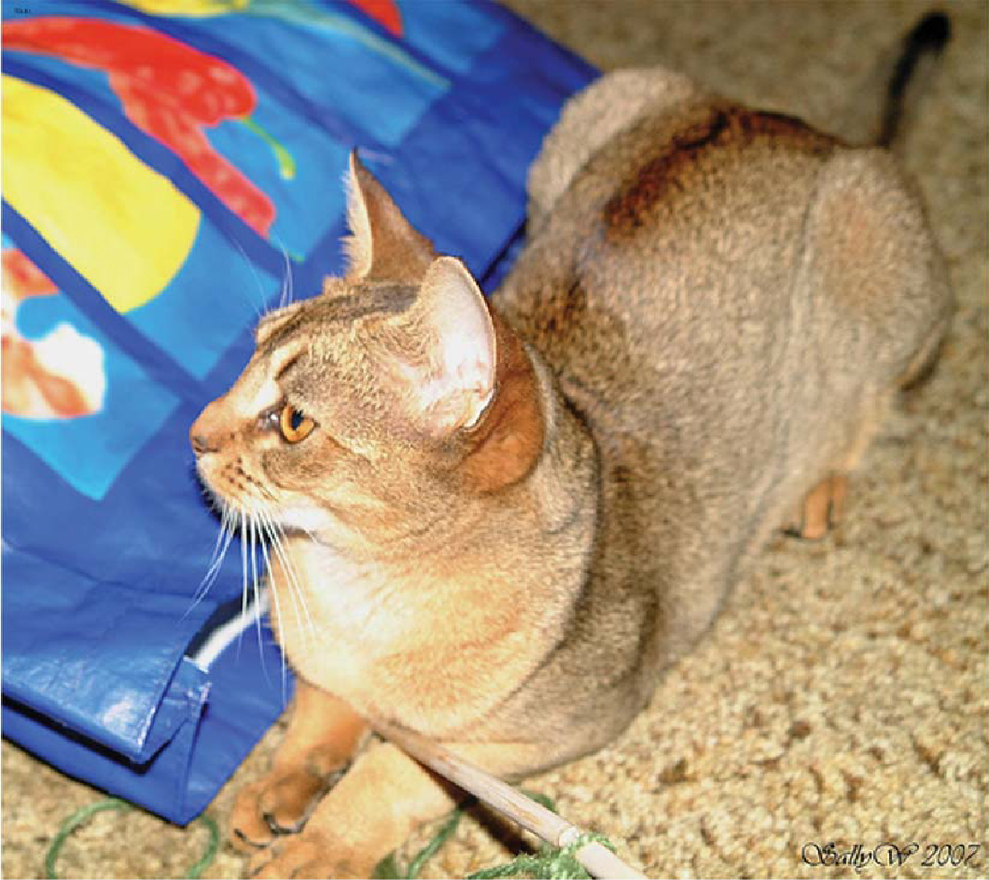

Image Segmentation
Training image Segmentation mask

Slide 7
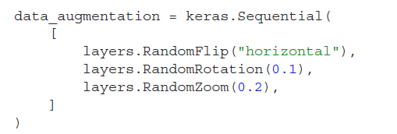
Data Augmentation
Data augmentation takes the approach of generating more training data from existing training samples by augmenting the samples via a number of random transformations that yield believable-looking images.
The goal is that, at training time, the model will never see the exact same picture twice.
This helps expose the model to more aspects of the data so it can generalize better.
In Keras, implement data augmentation by adding data augmentation layers at the start of the model.

Slide 8
Data Augmentation
In Keras, implement data augmentation by adding data augmentation layers at the start of the model.
RandomFlip("horizontal")—Applies horizontal flipping to a random 50% of the images that go through it
RandomRotation(0.1)—Rotates the input images by a random value in the range [–10%, +10%] (these are fractions of a full circle—in degrees, the range would be [–36 degrees, +36 degrees])
RandomZoom(0.2)—Zooms in or out of the image by a random factor in the range [-20%, +20%]

Slide 9
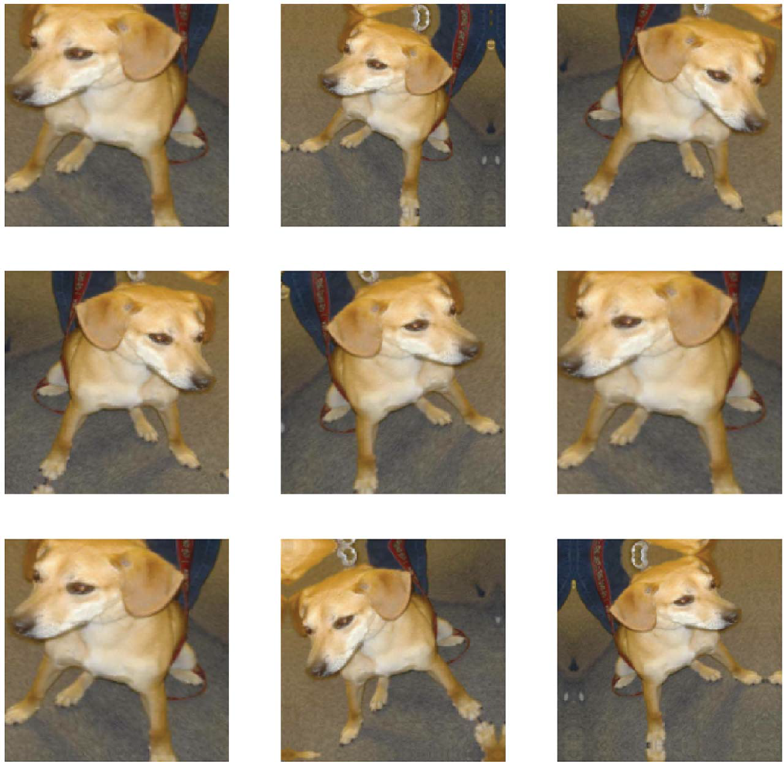
Data Augmentation: Randomly augmented images of dogs

Slide 10
Pre-trained Model
A pre-trained model
is common and highly effective approach to deep learning on small image datasets.
was previously trained on a large dataset, typically on a large-scale image-classification task
if this original dataset is large enough and general enough, the spatial hierarchy of features learned by the pretrained model can effectively act as a generic model of the visual world, and
features of the pretrained can prove useful for many different computer vision problems, even though these new problems may involve completely different classes than those of the original task
CNNs used for image classification comprise two parts:
(1) start with a series of pooling and convolution layers, and
(2) end with a densely connected classifier.
The first part of CNNs is called the convolutional base of the model.
In the case of CNNs, feature extraction consists of taking the convolutional base of a previously trained network, running the new data through it, and training a new classifier on top of the output

Slide 11
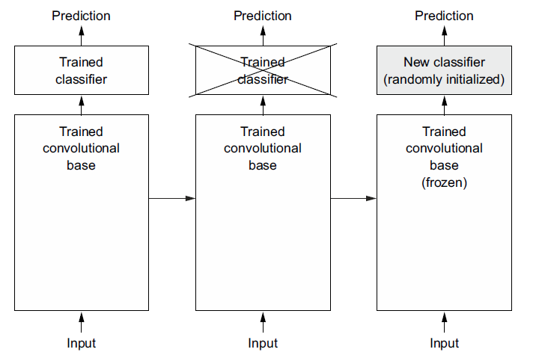
Pre-trained Model: Feature Extraction through Convolutional Base

Slide 12
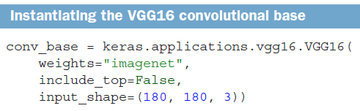
Pre-trained Models in Keras
A pre-trained model in Keras
VGG16
Xception
ResNet
MobileNet
EfficientNet
DenseNet

Slide 13
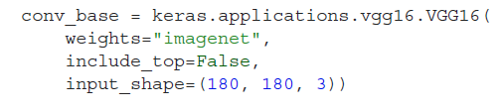
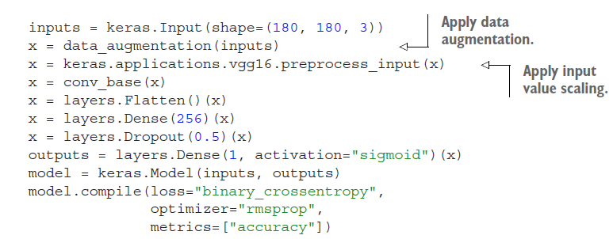
Pre-trained Models in Keras with Feature Extraction & Data Augmentation
Create a new model that chains together
A data augmentation stage
Uses frozen convolutional base
A dense classifier

Slide 14
Fine-Tuning Pre-trained Models
Unfreezing a few of the top layers of a frozen model base used for feature extraction, and jointly training both the newly added part of the model and these top layers.
Fine-tuning slightly adjusts the more abstract representations of the model being reused in order to make them more relevant for the problem at hand.
Steps to fine-tune pre-trained model:
Add our custom network on top of an already-trained base network.
Freeze the base network.
Train the part we added.
Unfreeze some layers in the base network. (do not unfreeze “batch normalization” layers)
Jointly train both these layers and the part are added.

Slide 15
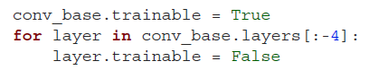
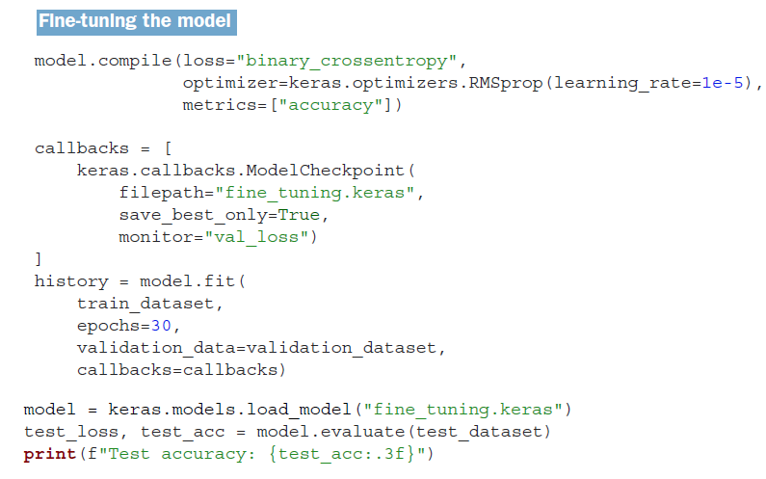
Fine-Tuning Pre-trained Models: Using Keras
Unfreeze layer(s)
connected to the
classifier layer

